Slide 1


SUBMISSION ID: 105
UNLOCKING THE COLOMBO STOCK EXCHANGE: LEVERAGING SENTIMENT ANALYSIS, TECHNICAL INDICATORS, AND BEHAVIORAL ECONOMICS IN COMPUTERIZED TRADING
Senarathna B. S.¹*, Abeynayake A. D. L.², and Deshani K. A. D.³
^{1,3}Department of Statistics, University of Colombo, Sri Lanka, ²Acuity Knowledge Partners, Sri Lanka
Presented by: Buddhima S. Senarathna

Slide 2
Overview
PROBLEM
1
LITERATURE
2
RESEARCH GAP
3
OBJECTIVES
4
INTRODUCTION
5
BACKGROUND
6
METHODOLOGY
7
IMPLEMENTATION
8
RESULT
9
CONCLUSION
10
FUTURE DIRECTION
11
PAGE 02 - 20

Slide 3

Problem Statement
The underutilization of sentiment analysis in algorithmic trading presents an opportunity to gain a competitive advantage in the Colombo Stock Exchange. By incorporating investor and company-related sentiment data, traders can develop more comprehensive and profitable strategies.
PAGE 03 - 20

Slide 4
Literature Review
Combining sentiment with technical indicators allows for a more comprehensive perspective.
Neely, C., Weller, P. and Dittmar, R. (1997) ‘Is Technical Analysis in the Foreign Exchange Market Profitable? A Genetic Programming Approach’, Journal of Financial and Quantitative Analysis, 32(4), pp. 405–426. Available at: https://EconPapers.repec.org/RePEc:cup:jfinqa:v:32:y:1997:i:04:p:405-426_00.
Sentiment analysis, a complementary approach, evaluates investor sentiment from financial news to predict market moves. Studies show that syntactic features, such as noun-verb combinations, provide better sentiment predictions, outperforming traditional methods on precision and recall.
Kaya, M.I.Y. and Karsligil, M.E. (2010) ‘Stock price prediction using financial news articles’, in 2010 2nd IEEE International Conference on Information and Financial Engineering. IEEE, pp. 478–482. Available at: https://doi.org/10.1109/ICIFE.2010.5609404.
Sentiment analysis has emerged as a crucial tool in algorithmic trading, helping traders understand market participants’ emotions and attitudes.
Das, S.R. and Chen, M.Y. (2007) ‘Yahoo! for amazon: Sentiment extraction from small talk on the Web’, Management Science, 53(9), pp. 1375–1388. Available at: https://doi.org/10.1287/mnsc.1070.0704.
In the Sri Lankan context, research on the Colombo Stock Exchange (CSE) is limited, with notable studies comparing RNN strategies, revealing insights into potential profitability.
Priyadarshna M D S L (2021) Identifying CSE market signals by integrating technical analysis with machine learning techniques.
PAGE 04 - 20

Slide 5

RESEARCH QUESTION
What impact does incorporating sentiment analysis alongside technical indicators have on the performance of algorithmic trading strategies in volatile markets?
OBJECTIVES
Acquire Data
Develop Forecasting Models
Explore Methodologies
Refine Strategies
Create Integrated Approach.
Build Decision Tools
PAGE 05 - 20

Slide 6

Introduction
Algorithms are step-by-step procedures or formulas designed to solves pecific problems or perform tasks in computing and various fields.
Trading algorithms are computer-generated instructions designed to execute automated buy or sell orders in financial markets based on predefined criteria and strategies.
For that:
Technical analysis involves evaluating historical price charts and trading volumes to forecast future price movements in financial markets
With a new addition:
Financial sentiment analysis involves assessing and interpreting market participants' emotions, opinions, and attitudes toward financial assets to inform investment decisions.
PAGE 06 - 20

Slide 7
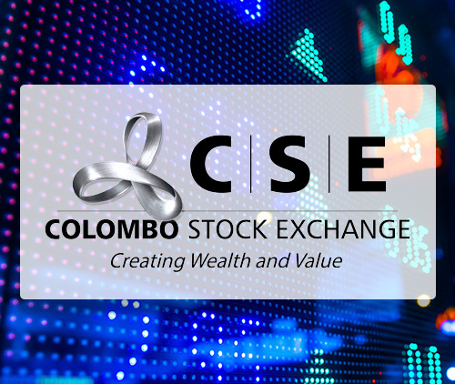
Background
Colombo Stock Exchange
Regulation: Overseen by the Securities and Exchange Commission of Sri Lanka (SEC) to ensure transparency and fairness.
Market Overview: Operates indices like the ASPI and S&P SL20, trading both equity and debt securities, including stocks, bonds, and government securities.
Participants: Comprises over 290 listed companies.
S&P SL20
Index Type: The S&P SL20 is a market-capitalization-weighted index.
Market Representation: Features companies across diverse sectors, offering a benchmark for large-cap performance in Sri Lanka.
Investor Appeal: Widely recognized by local and international investors, enhancing market visibility and attracting global interest.
PAGE 07 - 20

Slide 8
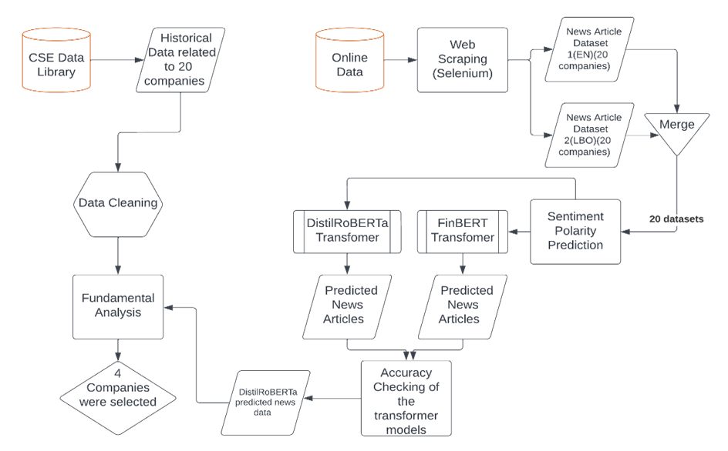
Methodology
PHASE 01
PAGE 08 - 20

Slide 9

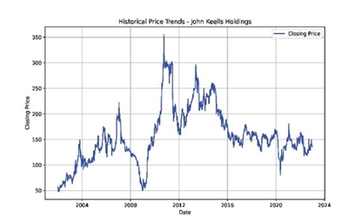
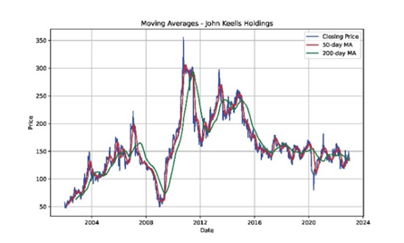
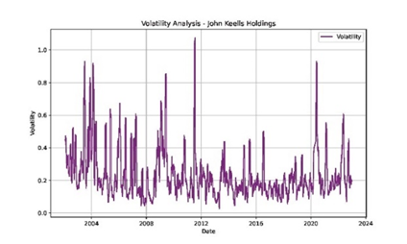
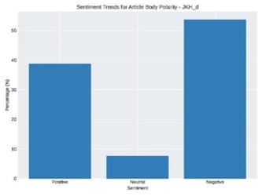
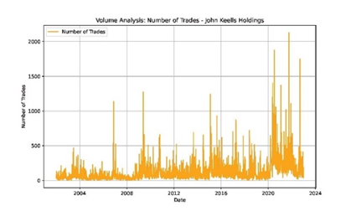
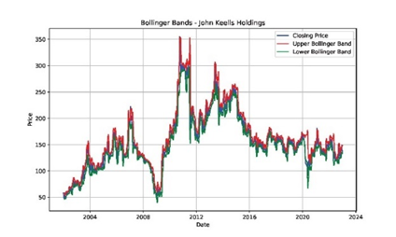
4 Companies were selected
Company 1
Company 2
Company 3
Company 4
Fundamental Analysis
PAGE 09 - 20

Slide 10
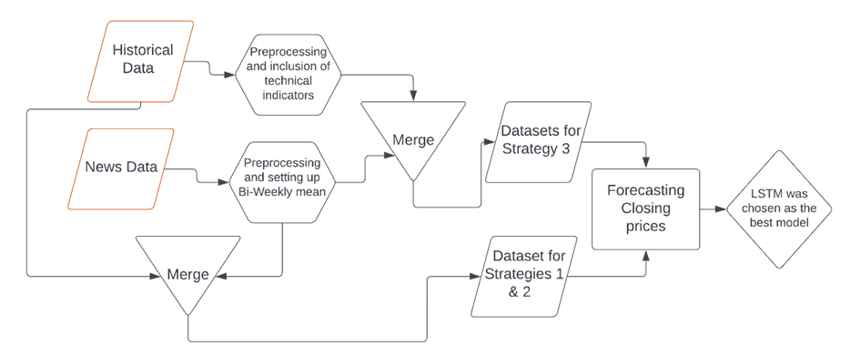
Methodology
PHASE 02
PAGE 10 - 20

Slide 11
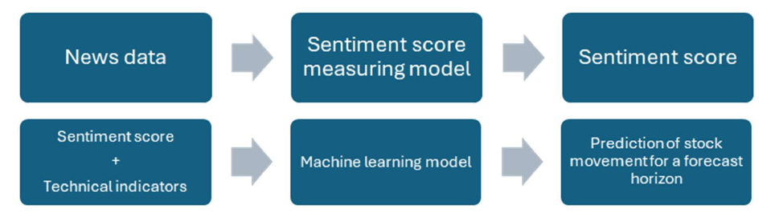
Strategies
Strategy 1 & 2
Strategy 3
PAGE 11 - 20

Slide 12
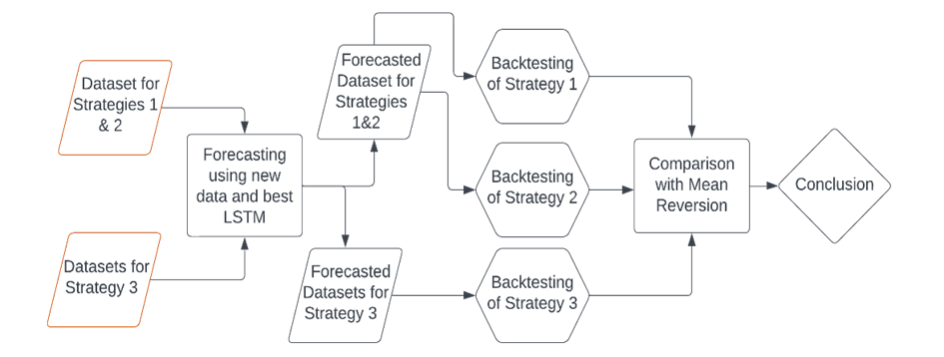
Methodology
PHASE 03
PAGE 12 - 20

Slide 13
Implementation
ARIMA
Displayed overfitting
High AIC values
Did not provide a model for Company 4 data
XGBoost
Displayed overfitting
Used lags to reduce overfitting but no huge improvement
Random Forest
Displayed overfitting
Larger gap between Train and Test RMSE
LSTM
Lesser to no overfitting comparatively
Higher ATA and R2 values
PAGE 13 - 20

Slide 14
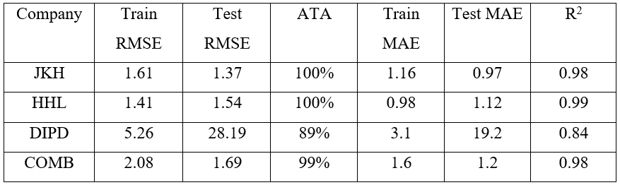
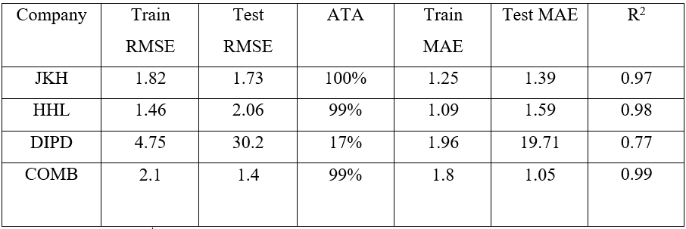
Result
Best Forecasting Model - LSTM
Results of the Forecasting Model used for for Strategy 1&2
Results of the Forecasting Model used for for Strategy 3
Company 1
Company 1
Company 2
Company 2
Company 3
Company 3
Company 4
Company 4
LSTM was chosen to forecast the daily closing prices to backtest the strategies
PAGE 14 - 20

Slide 15
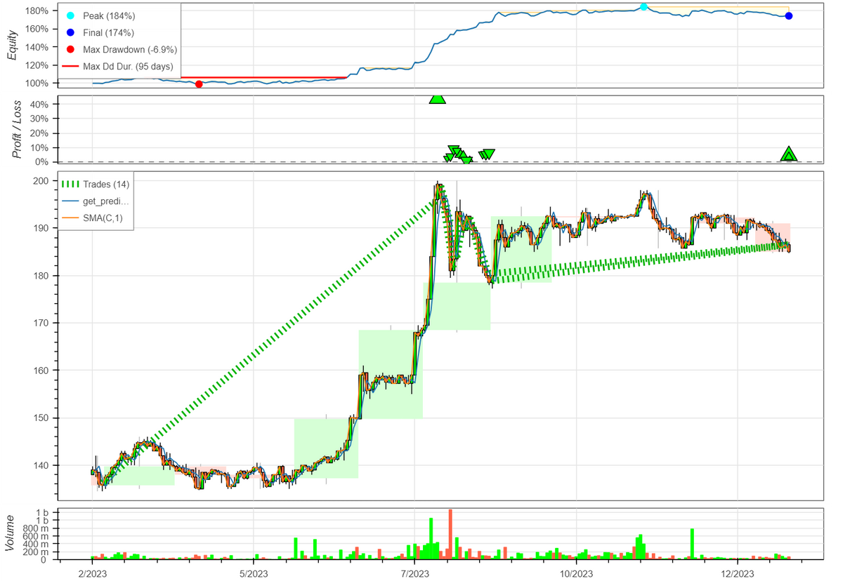
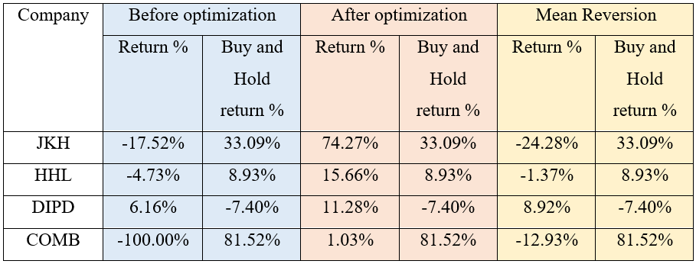
Result
Backtesting Strategy 1
Company 1
Company 2
Company 3
Company 4
All the models have outperformed the Mean Reversion Strategy.
All the models except for Company 4 has outperformed the Buy and Hold Strategy.
PAGE 15 - 20

Slide 16
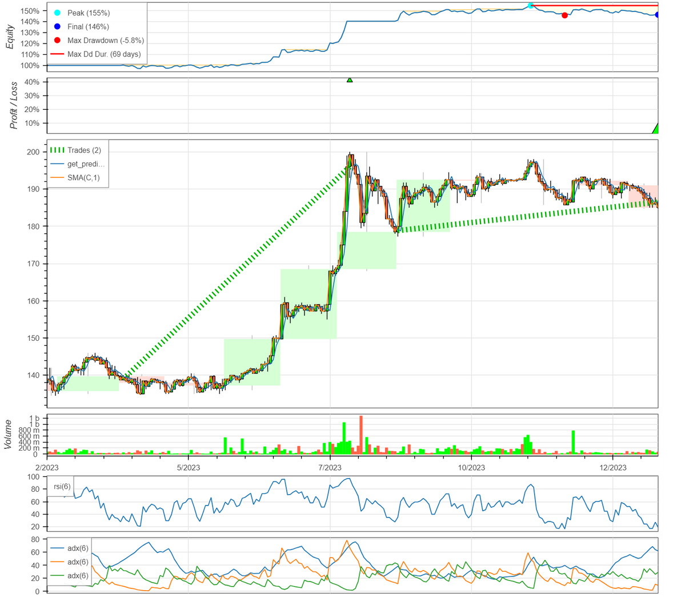
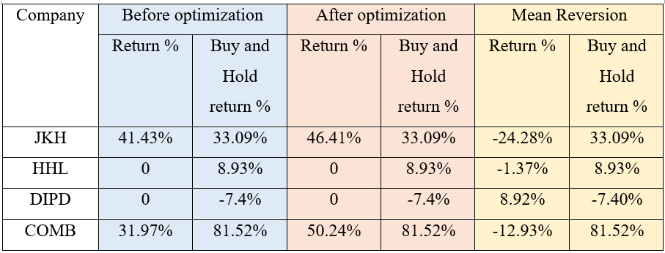
Result
Backtesting Strategy 2
Company 1
Company 2
Company 3
Company 4
All the models have outperformed the Mean Reversion Strategy except for Company 3.
All the models except for Company 2 and Company 4 have outperformed the Buy and Hold Strategy.
PAGE 16 - 20

Slide 17
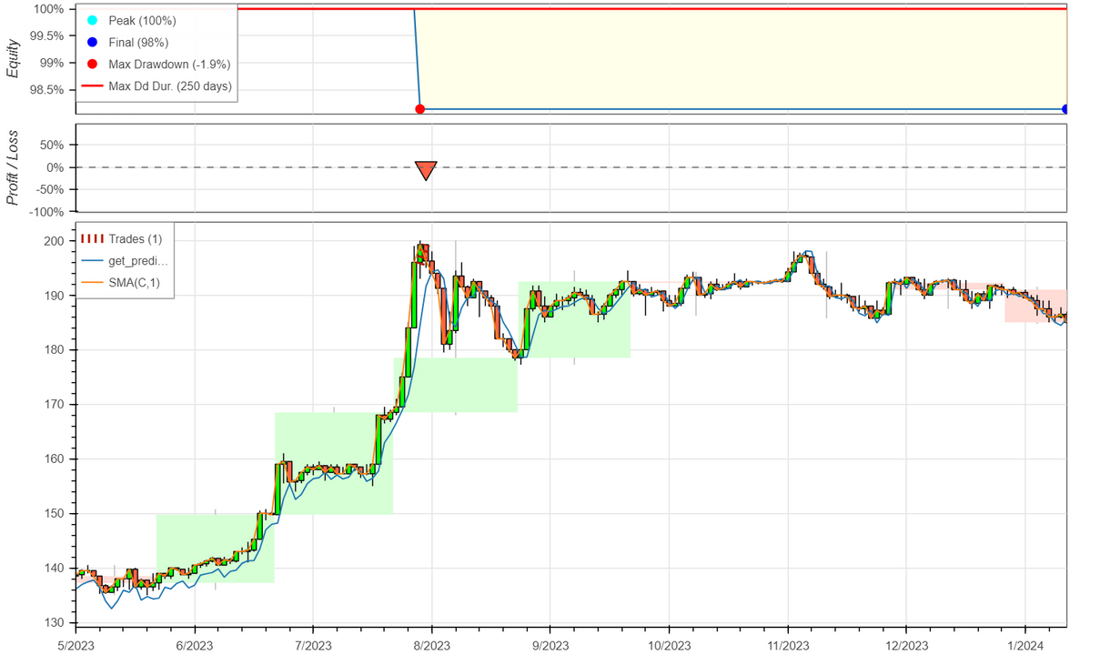
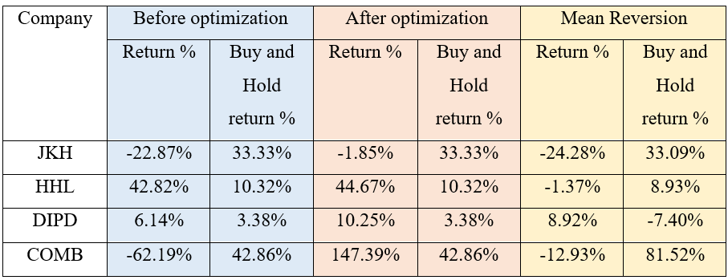
Result
Backtesting Strategy 3
Company 1
Company 2
Company 3
Company 4
All the models have outperformed the Mean Reversion Strategy.
All the models except for Company 1 has outperformed the Buy and Hold Strategy.
PAGE 17 - 20

Slide 18

Conclusion
Model Performance: The LSTM model consistently outperforms other models in forecasting daily closing stock prices.
Strategy 1: Demonstrates superior performance compared to the Mean Reversion Strategy (MRS), especially for less volatile companies.
Strategy 2: Offers mixed results, outperforming MRS for highly volatile stocks.
Strategy 3: Performance varies, with positive effects for some companies but negative impacts on others. Requires further refinement.
PAGE 18 - 20

Slide 19
Future Direction
Expanded Analysis: Future research could analyze all companies in the S&P SL20 index for a broader understanding of market dynamics and sentiment-driven trading.
Enriched Sentiment Analysis: Incorporating diverse news sources and using expert-annotated sentiment polarity could enhance the reliability and depth of sentiment analysis.Advanced
Forecasting Techniques: Exploring methods like RNNs, Fuzzy Systems, Multivariate Time Series Forecasting, and SARIMA could refine predictive models and performance evaluation.
Optimized Backtesting: Improved backtesting measures, including optimizing Sharpe and Sortino Ratios, could enhance the evaluation of trading strategy effectiveness and risk management.
PAGE 19 - 20

Slide 20
THANK YOU

